Slide 1



Lecture 1a
Machine Learning
Master in Big Data Solutions 2020-2021 - Artificial Intelligence
Xavier Giró
xavier.giro@bts.tech

Slide 2



Acknowledgements
Kevin McGuinness
kevin.mcguinness@dcu.ie
Research Fellow
Insight Centre for Data Analytics
Dublin City University

Slide 3


Slide 4
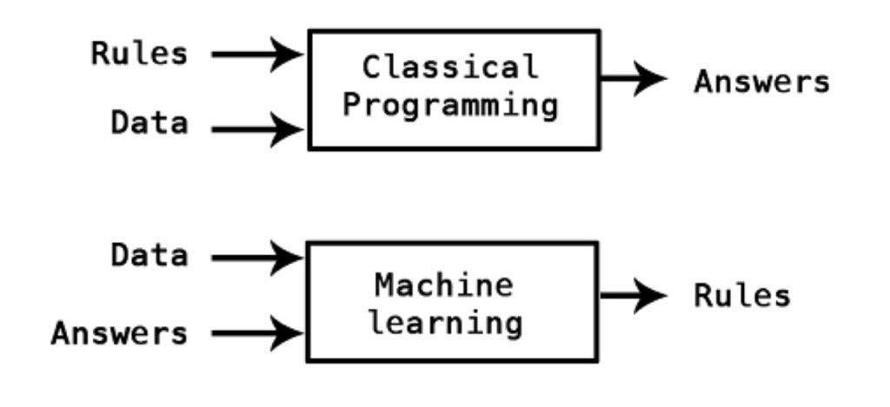

Slide 5

Representation + Learning pipeline
Probabilities:
CAT: 0.7
DOG: 0.3
Raw data (ex: images)
X1: weight
X2: age
Feature Extraction
Classifier
Decisor
y = ‘CAT’
Slide concept: Santiago Pascual (UPC 2019). Garfield is a character created by Jim Davis.

Slide 6
Representation + Learning pipeline
Probabilities:
CAT: 0.7
DOG: 0.3
Raw data (ex: images)
X1: weight
X2: length
Feature Extraction
Classifier
Decisor
y = ‘CAT’
Shall we extract features now?
Neural Network
Slide concept: Santiago Pascual (UPC 2019). Garfield is a character created by Jim Davis.

Slide 7
End-to-end Representation Learning
End to End concept
Probabilities:
CAT: 0.7
DOG: 0.3
Raw data (ex: images)
Classifier
Decisor
y = ‘CAT’
We CAN inject the raw data, and features will be learned in the NN !!
Neural Network
Slide concept: Santiago Pascual (UPC 2019). Garfield is a character created by Jim Davis.

Slide 8
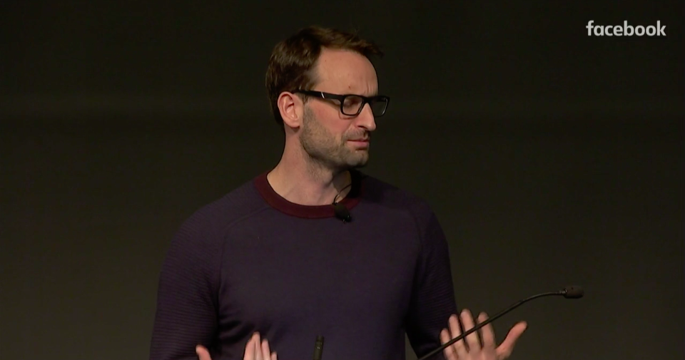
Machine Learning
 | ...with a teacher | ...without a teacher
Active agent... | Reinforcement learning (with extrinsic reward) | Intrinsic motivation / Exploration.
Passive agent... | Supervised learning | Unsupervised learning
Slide inspired by Alex Graves (Deepmind) at
“Unsupervised Learning Tutorial” @ NeurIPS 2018.

Slide 9
Machine Learning
 | ...with a teacher | ...without a teacher
Active agent... | Reinforcement learning (with extrinsic reward) | Intrinsic motivation / Exploration.
Passive agent... | Supervised learning | Unsupervised learning
Slide inspired by Alex Graves (Deepmind) at
“Unsupervised Learning Tutorial” @ NeurIPS 2018.

Slide 10
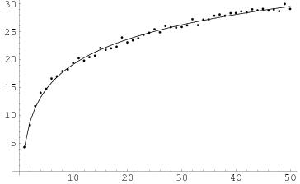
Supervised learning
Fit a function: 𝐲 = ƒ(𝐱), 𝐱 ∈ ℝ^{m}

Slide 11
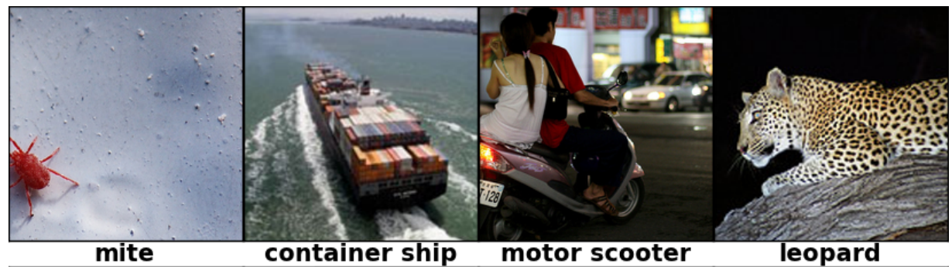
Supervised learning
Fit a function: 𝐲 = ƒ(𝐱), 𝐱 ∈ ℝ^{m}
Given paired training examples {(x_{i}, y_{i})}
x_{i}
y_{i}

Slide 12

Supervised learning
Fit a function: 𝐲 = ƒ(𝐱), 𝐱 ∈ ℝ^{m}
Given paired training examples {(x_{i}, y_{i})}
Key point: generalize well to unseen examples

Slide 13
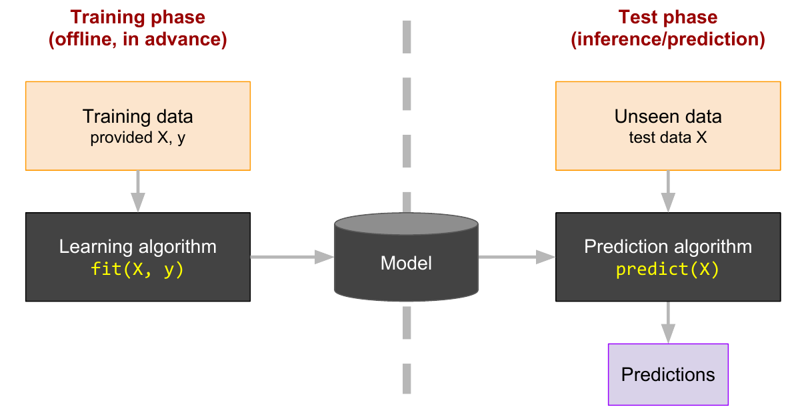
Black box abstraction of supervised learning
^
y

Slide 14
Regression vs Classification
Depending on the type of target 𝐲 we get:
Regression: 𝐲 ∈ ℝ^{N} is continuous (e.g. temperatures 𝐲 = {19º, 23.2º, 22.8º})
Classification: 𝐲 is discrete (e.g. 𝐲 = {“dog”,”cat”,”ostrich”}).

Slide 15
Regression vs Classification
Depending on the type of target 𝐲 we get:
Regression: 𝐲 ∈ ℝ^{N} is continuous (e.g. temperatures 𝐲 = {19º, 23.2º, 22.8º})
Classification: 𝐲 is discrete (e.g. 𝐲 = {“dog”, “cat”, “ostrich”}).

Slide 16
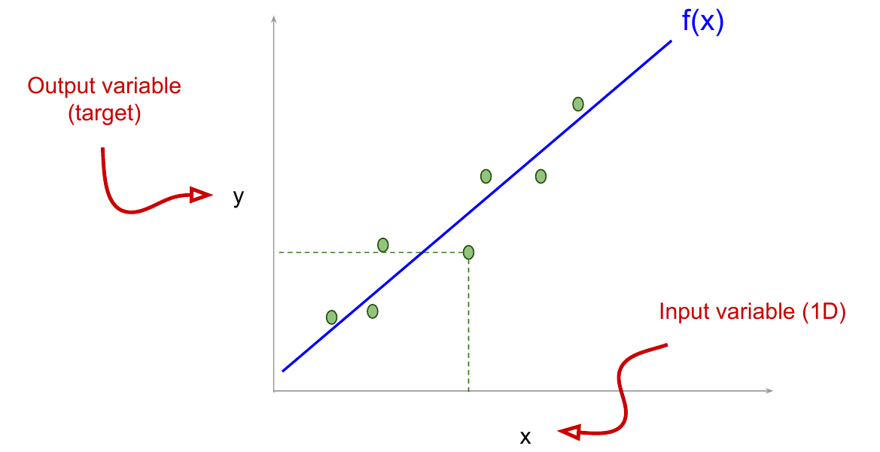
Linear Regression (eg. 1D input - 1D ouput)

Slide 17
Linear Regression (eg. 1D input - 1D ouput)
Training this model means learning parameters w and b from data.
= w · x + b

Slide 18

Linear Regression (eg. M-D input - 1D output)
Input data can also be M-dimensional with vector x:
y = w^{T} · x + b = w1·x1 + w2·x2 + w3·x3 + … + wM·xM + b
e.g. we want to predict the price of a house (y) based on:
x1 = square-meters (sqm)
x2,3 = location (lat, lon)
y = price = w1·(sqm) + w2·(lat) + w3·(lon)+ b

Slide 19
Regression vs Classification
Depending on the type of target 𝐲 we get:
Regression: 𝐲 ∈ ℝ^{N} is continuous (e.g. temperatures 𝐲 = {19º, 23.2º, 22.8º})
Classification: 𝐲 is discrete (e.g. 𝐲 = {”dog”,”cat”,”ostrich”}).

Slide 20
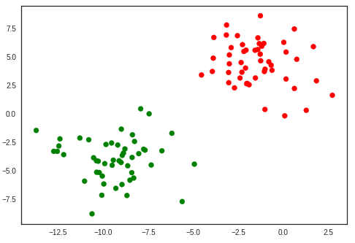
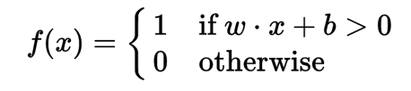

Binary Classification (eg. 2D input, 1D ouput)
2D feature space
Length
Weight
Slide inspiration: Santiago Pascual (UPC TelecomBCN 2019). Garfield and Odie are characters created by Jim Davis.

Slide 21
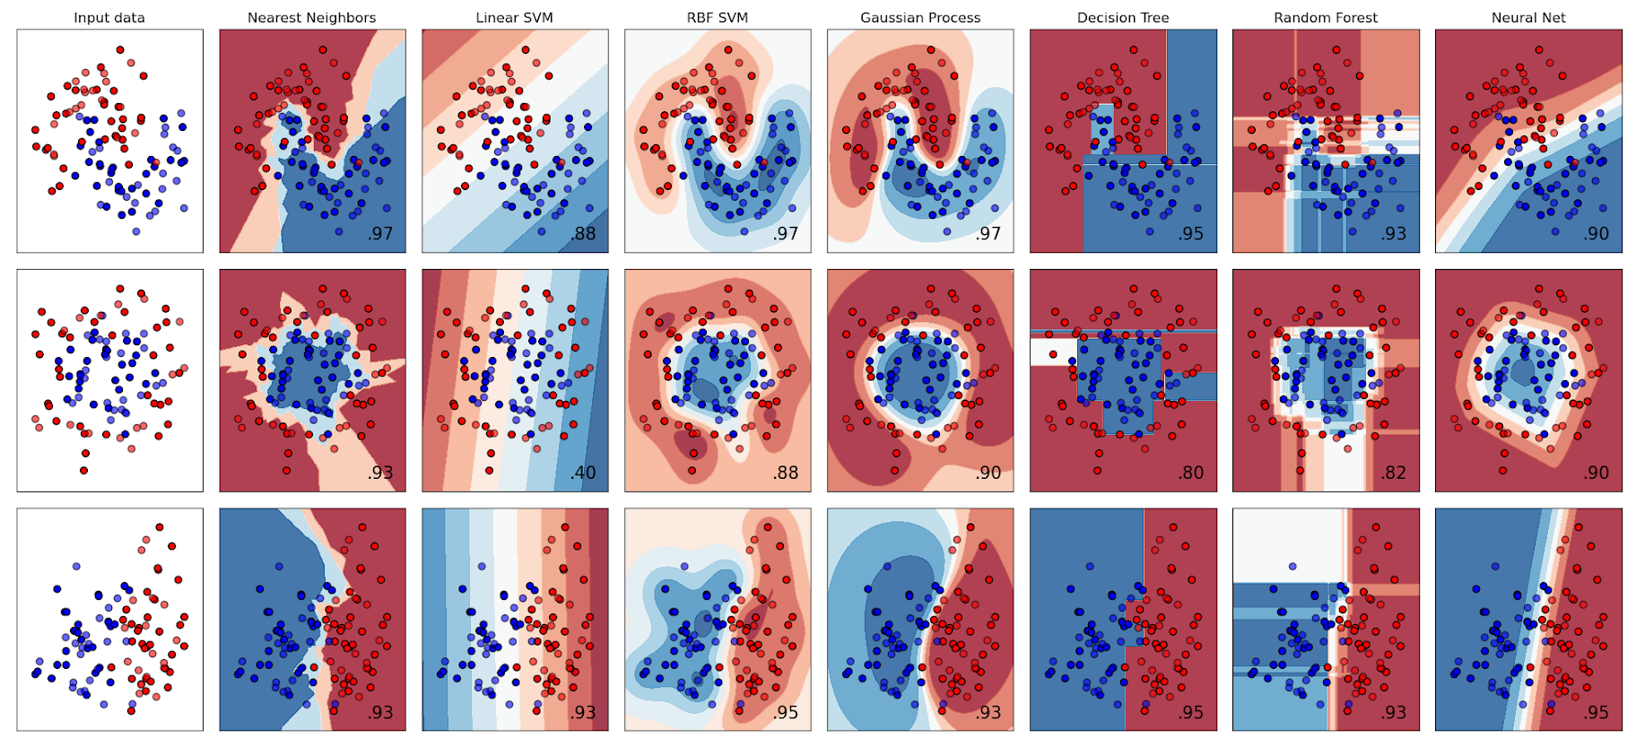
Binary Classification (eg. 2D input, 1D ouput)
Source: Classifier comparison in scikit-learn [related tweet]

Slide 22
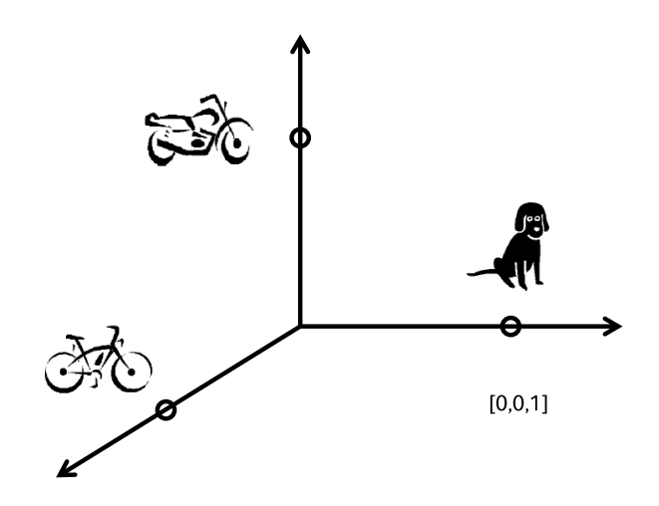
Multi-class Classification (N-D output)
Classification: 𝐲 is discrete (e.g. 𝐲 = {”dog”,”bike”,”motorbike”}.
Classes are often coded as one-hot vector (each class corresponds to a different dimension of the output space)
[0,1,0]
One-hot representations
[1,0,0]
[0,0,1]
Perronin, F., CVPR Tutorial on LSVR @ CVPR’14, Output embedding for LSVR

Slide 23
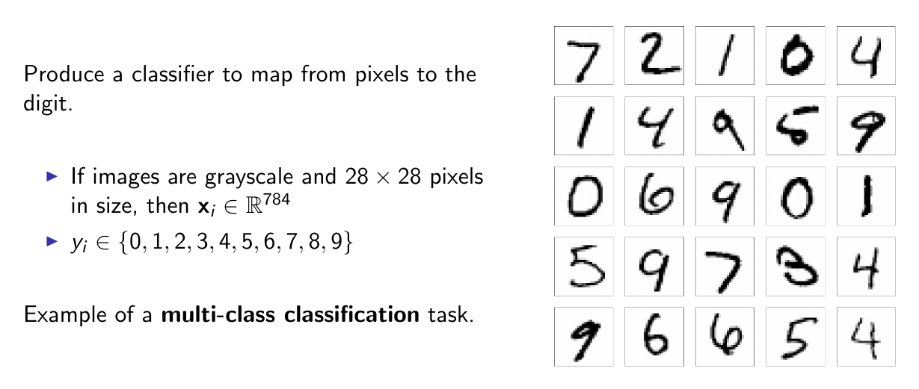
Multi-class Classification (N-D output)
Handwritten Digits from the MNIST dataset

Slide 24
Multi-class Classification (N-D output)
Number of words, |V| ?
B2: 5K
C2: 18K
LVSR: 50-100K
Wikipedia (1.6B): 400K
Crawl data (42B): 2M
cat: x^{T} = [1,0,0, ..., 0]
dog: x^{T} = [0,1,0, ..., 0]
.
.
house: x^{T} = [0,0,0, …,0,1,0,...,0]
.
.
.
One-hot representations

Slide 25

Discussion
Can intelligence be modelled by curve fitting ? (click on the tweet to read the thread discussion for arguments)

Slide 26

Questions ?

